Slide 1
AAHA BHOJANAMBU
Product Management Case Study
Done By- Maheedar Balivada
Gmail:- maheedarb@gmail.com
Linkedin:- www.linkedin.com/in/maheedarbalivada

Slide 2
Introduction
Aaha Bhojanambu was a local dine-in and takeaway restaurant in Srikakulam, a small town in Andhra Pradesh, known for its affordable and tasty South Indian cuisine. It focused on bringing traditional flavors from different districts of Andhra Pradesh to one place. Despite good reviews on platforms like Google, Swiggy, and Zomato, and a strong customer preference for its menu and ambience, the restaurant failed due to operational and financial challenges. This case study analyzes the reasons for failure and proposes a product management-led solution to improve sustainability and profitability.

Slide 3
Problem Statement
Although the restaurant had an appealing menu, great taste, affordability, and ambience, it struggled to generate consistent profits. A significant issue was the customer behavior in Srikakulam: people shared one item among multiple people, often ordering less and consuming more. Customers also negotiated prices and avoided ordering full meals. These habits, combined with seasonal demand, lack of revenue tracking, and no structured financial planning, led to revenue losses. The restaurant lacked digital systems to track orders or analyze customer behavior, resulting in poor decision-making.

Slide 4
User Research & Survey Insights
Findings: - Students prefer combos due to budget constraints and a desire to try multiple dishes. - Families share meals as a habit and for budget control. - Working professionals may afford meals individually but still share due to social norms. - People valued taste, ambience, and affordability over branding. Sharing was not viewed negatively by customers but was a coping mechanism due to budget and portion sizes. The restaurant never addressed this behavior strategically.

Slide 5
Personas
1. Rishi – Student / Part-time Delivery Person - Goals: Eat high-portion meals on a low budget. - Pain Points: Long wait times, affordability. - Quote: "I want food in less time.“
2. Rajesh – Working Professional - Goals: Tasty and clean food after work. - Pain Points: Poor hygiene perception, long waiting time. - Quote: "Food should be quick and hygienic."

Slide 6
Personas
3. Lakshmi – Homemaker / Family Oriented - Goals: Affordable meals for family outings. - Pain Points: Limited budget, food should satisfy everyone. - Quote: "Good taste at less cost makes the outing perfect."

Slide 7
Personas
4. Suresh – Restaurant Owner - Goals: Manage profits, repay loans, serve good food. - Pain Points: Unpredictable revenue, customer behavior, poor tracking. 5. Chinna – Chef - Goals: Maintain food quality and speed. - Pain Points: Menu overload, bulk orders, poor communication.

Slide 8
Solution Features & Impact
1. Pre-Ordering via WhatsApp: - Users can place orders before arriving to reduce waiting time. - WhatsApp integration makes it simple for all age groups. 2. Combo Platters & Meal Sharing Optimization: - Platter for 3–4 people to minimize loss from sharing. - Pre-designed combos maintain portion control and value.

Slide 9
Solution Features & Impact
3. Revenue Stream Tracking: - Implement POS or app-based tracking for orders and payments. - Helps track daily profit, cost, and customer behavior. 4. Ambience Improvements: - Add TV/music to make the experience enjoyable. - Encourage longer stays and potential reorders.

Slide 10
Solution Features & Impact
Impact: Reduced chaos during rush hours, more efficient kitchen workflow, consistent profits through structured combos and revenue awareness.

Slide 11
SWOT Analysis
Strengths: - Affordable, tasty food with local flavors. - Good customer reviews and ambience. Weaknesses: - Lack of proper revenue tracking. - Loans outweigh profits.

Slide 12
SWOT Analysis
Opportunities: - Improved revenue stream planning. - Implementing tech solutions like pre-ordering. Threats: - Competition from fast food and bigger hotels. - Budget-conscious town with low per capita spending.

Slide 13
Competitive Analysis
Competitors: - Local hotels: Cheaper, but less hygienic. - High-end restaurants: Better service and capital but expensive. Aaha Bhojanambu's Advantage: - Combos and variety from different districts. - Affordability and family-friendly atmosphere. Competitor Drawback: - Higher pricing, less personalized experience.

Slide 14
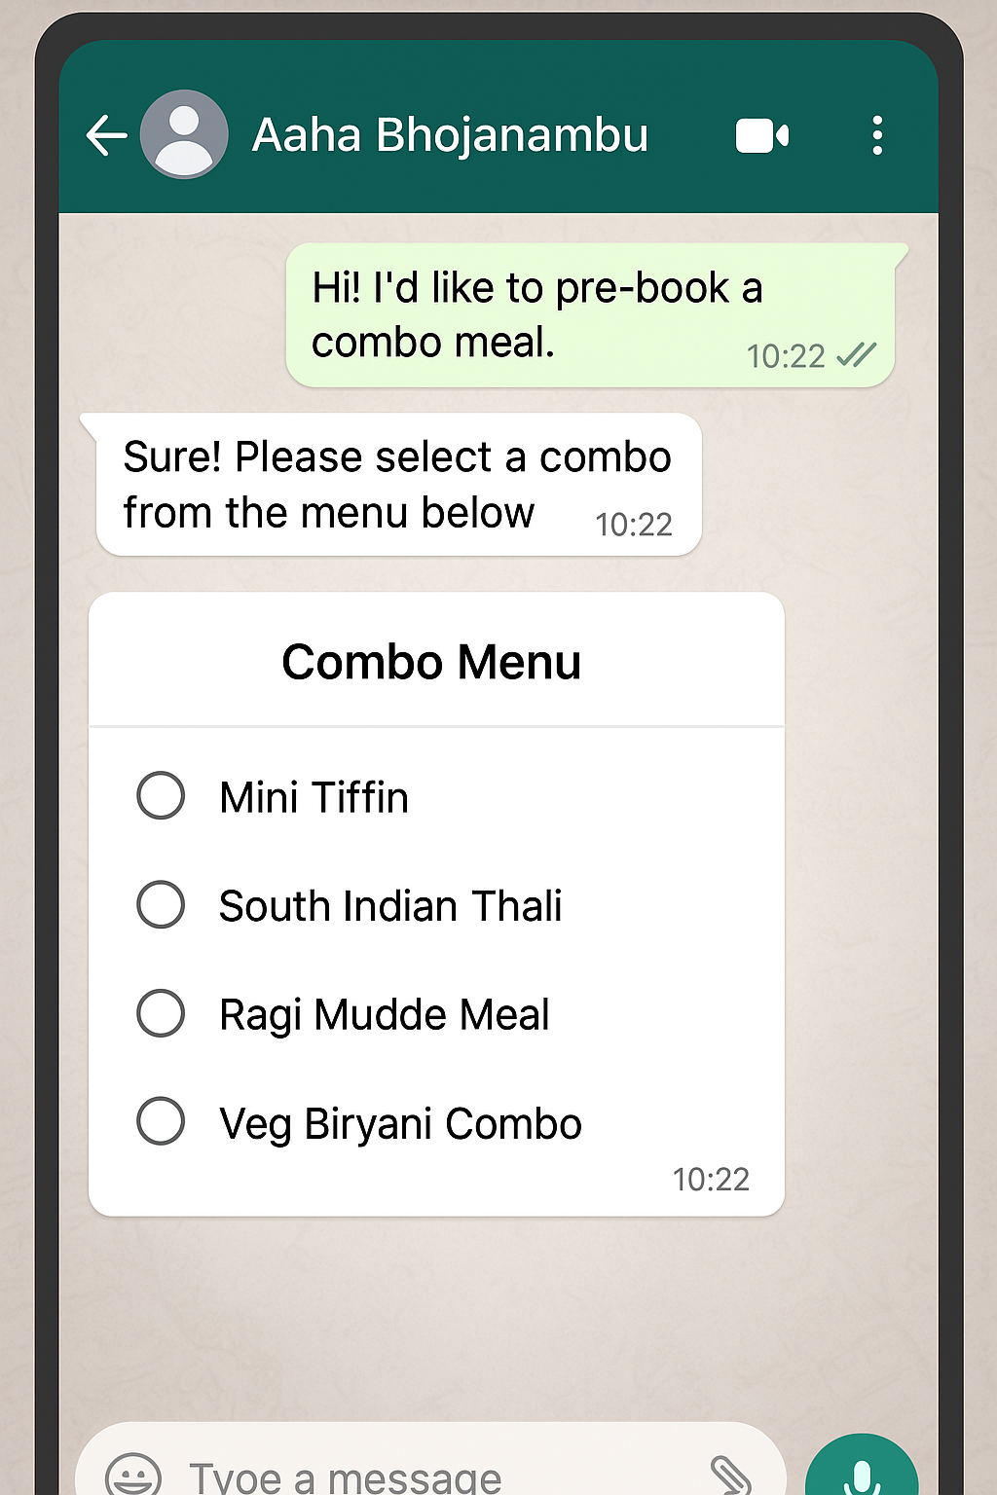
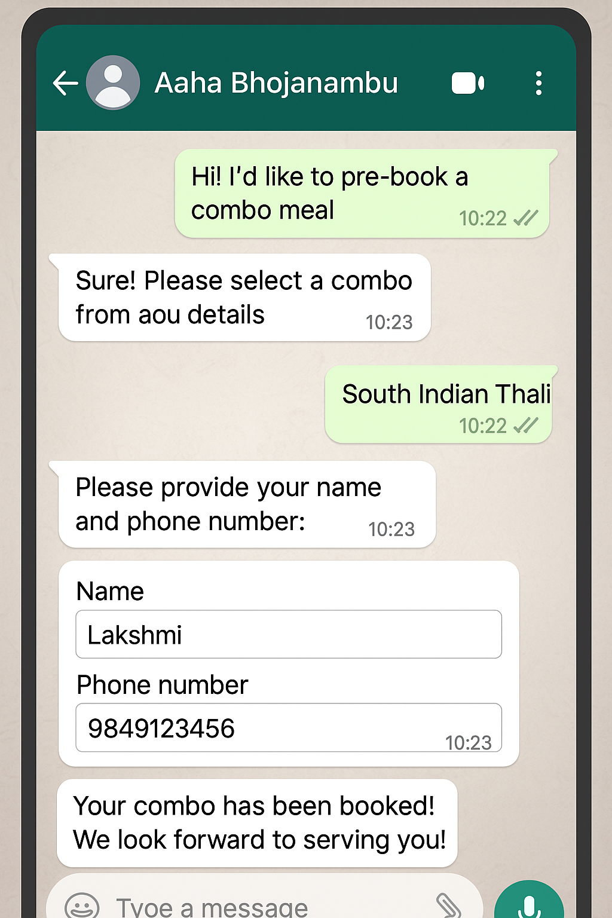
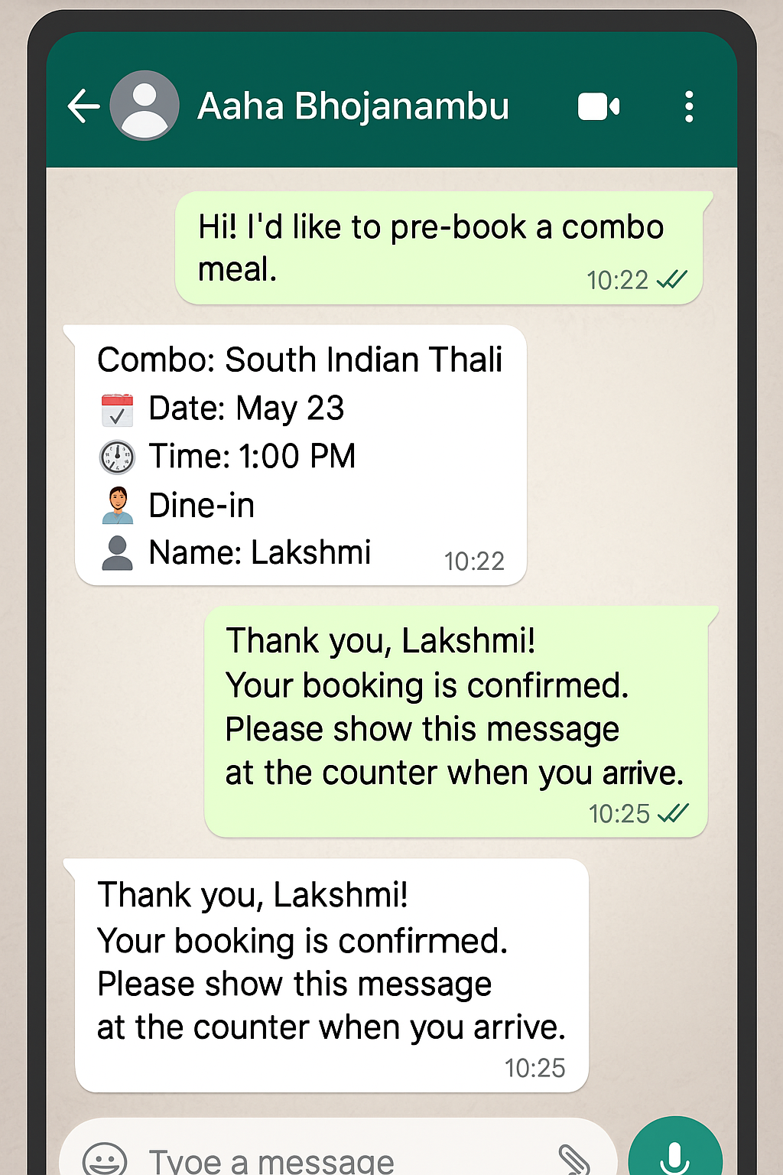
Wire frames for WhatsApp pre booking feature:
Pre booking Menu
Food selection
Confirmation details

Slide 15
Business Metrics & Tracking
Key Metrics: 1. Daily order volume (dine-in, takeaway) 2. Average order value (especially from combos) 3. Pre-booking frequency via WhatsApp 4. Customer return rate 5. Profit margins after tracking costs vs revenue Tools: Basic POS system or Google Sheets integration to track these metrics weekly and monthly.

Slide 16
Conclusion and Learnings
This case study reflects how understanding user behavior in small towns is vital. The failure of Aaha Bhojanambu wasn't due to poor food or service but the lack of a system to manage revenue, customer expectations, and operational workflow. As a product management learner, I understood how small changes like pre-ordering and combo design can solve deep-rooted business problems. This project helped me apply research, empathy, journey mapping, and solution framing in a real-life business context.

